Slide 1
Zowe Overview
Zowe™, the Zowe™ logo, and the Open Mainframe Project™ are trademarks of The Linux® Foundation

Slide 2
Agenda
What is Zowe?
LTS Release Overview
Zowe Conformance Program
Zowe Features Here and Beyond - Enterprise and Production Ready
How to get involved
Q/A

Slide 3
What is Zowe?

Slide 4
What is Zowe?
Zowe is an open source project hosted by the Open Mainframe Project and Linux Foundation, available under the Eclipse Public License - v 2.0
Zowe was announced at SHARE in August 2018, with the 1.0 GA release in February 2019. Initial contributing organizations were Broadcom, IBM, and Rocket Software
The impetus for Zowe was the need for an open, modern and standard platform for application development on the mainframe

Slide 5
What is Zowe?
Zowe is an integrated and extensible open source ecosystem for z/OS with a coherent and curated set of user and programmatic interfaces that:
Provide consistent access to z/OS systems and services
Leverage industry standard methodologies and standards familiar to the vast majority of today’s developers
Are commonly accepted as a standard within the mainframe community
Zowe is delivered as a binary download and comes with a set of applications built on top of the framework that, together deliver a cloud-like integration experience that are intended to unify an organization's IT infrastructure and application delivery.
Notes:
Add this as a build – clean up and add visual

Slide 6
Zowe - Today
Zowe consists of four main active components and two incubation components

Slide 7




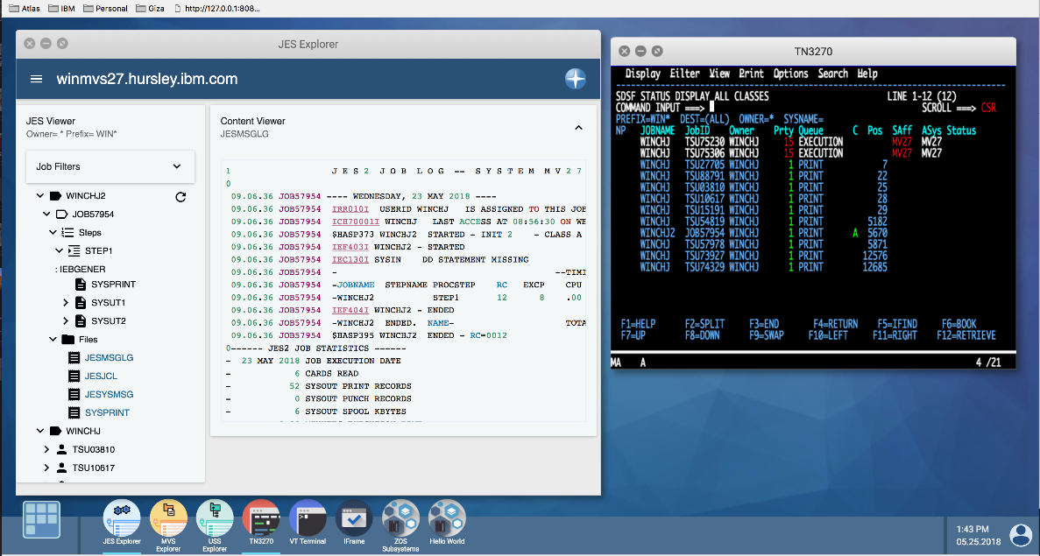
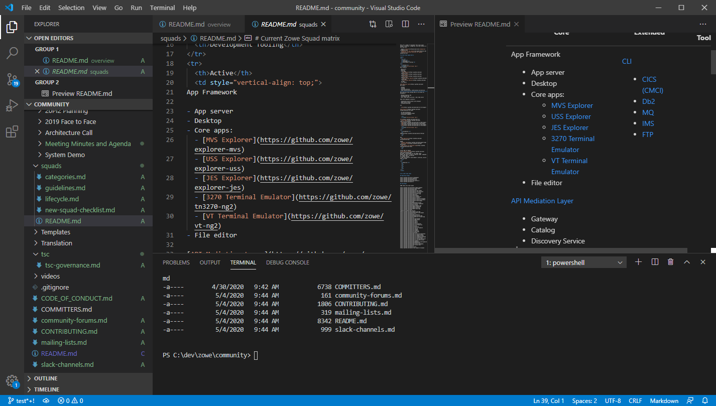

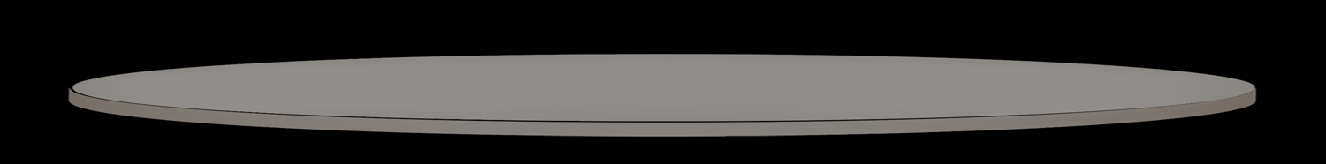
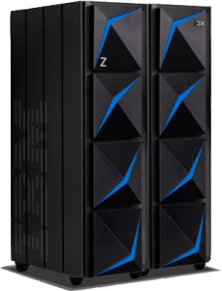
Zowe - Today
Ravi (DevOps)
Michelle (App Dev)
Tyler (Sys Admin)
Isabelle (Operator)
CODE
DEPLOY
PLAN
Plugins
BUILD
RELEASE
Plugins
OPERATE
TEST
MONITOR
CLI: build | deploy
Explorer
Application Framework
API Mediation Layer
Microservices
Notes:
API Mediation Layer and Microservices present access to many z/OS and z/OS subsystem services in an easy-to-manage and consume manner which is highly scalable. Ease of use features are SSO and swagger-based API documentation, browser, and tester
Click+1: One of the Zowe sub-systems that interfaces with the APIML is the CLI – blah blah blah
Click+2: Another Zowe sub-system that interfaces with APIML is Explorer – blah blah blah
Click+3: Another Zowe sub-system that interfaces with APIML is App Framework – blah blah blah
Click+4: The end-users of Zowe through these sub-systems are DevOps engineers, app developers, sysprogs, and operators
Click+5: All these come with built-in extensions for example to interface with special APIs (e.g. CICS-specific CLI commands) or desktop apps (e.g. 3270 emulator)
Click+6: Users and developers can also define their own extensions and interface them with existing microservices or new microservices they create
Click+7: Finally, users can invoke APIs through the APIML directly
In closing, what you see on this slide is what you get today when you download the Zowe binary from Zowe.org

Slide 8
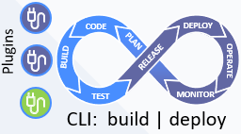
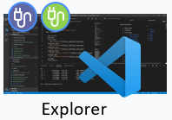
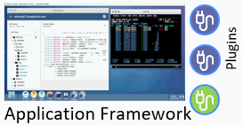
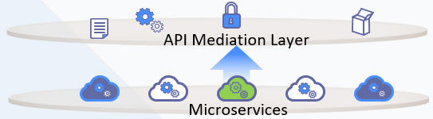
Zowe – Today (with incubation projects)
Ravi (DevOps)
Michelle (App Dev)
Tyler (Sys Admin)
Isabelle (Operator)
Zowe Mobile App (Incubation*)
Packages
Client Zowe SDK (Incubation*)
* Incubation sub-projects are research and
prototypes not ready for general consumption
** Extensibility of Zowe Explorer is in development
Notes:
However, there is more going on in Zowe today. Two additional projects are in incubation stage. These are available today to evaluate and to contribute to but they are not included in the binary download. One has to download the sources and build them yourself to try them out.
Blah blah blah

Slide 9
Zowe – Direction with incubation projects
Ravi (DevOps)
Michelle (App Dev)
Tyler (Sys Admin)
Isabelle (Operator)
Zowe Mobile App (Incubation*)
Client Zowe SDK (Incubation*)
Packages
* Incubation sub-projects are research and
prototypes not ready for general consumption
** Extensibility of Zowe Explorer is in development
Notes:
..more on future architecture direction based on incubating projects…

Slide 10
LTS Release Overview

Slide 11
Packaging and install – delivered!
“Vendor Neutral Package” for Single Zowe Instance
We want the same customer experience regardless of source of the code
CUPIDS = Componentized Update Package Install Distribute and Service
“Smarter” install – all components installed, selectively configured and activated “PARMLIB Model”
More flexible start options
Two areas needing additional development
How to determine a Zowe install is “genuine” to allow support from different vendors
What’s next after SMP/E
Portable Software Instance
Containers
NOW
Vendor Distribution 1
Zowe.org
Convenience Build (zowe release)
Pax file format
SMP/E format
Future releases=PTFs
Vendor Distribution 1
Vendor Distribution 1
Customer z/OS LPAR
Single Zowe instance
Optional Additional Zowe instances
Optional Additional Zowe instances

Slide 12
Why LTS?
Driver for LTS?
What does LTS mean?

Slide 13
Zowe LTS policies
The need for a new version will be considered at the beginning of each year.
New Zowe versions will enter current release status for six-nine months to allow consumers of Zowe to test, provide feedback and adjust to any changes.
After current release phase, Zowe will move to Active LTS status and will be deemed ready by the community for general use. Active LTS will have additional releases with both fixes and enhancements.
Following a period of Active LTS, the Zowe version will enter Maintenance for fixes only.

Slide 14
Current, Active LTS, Maintenance LTS
The combination of Active LTS and Maintenance LTS release is designated as long-term support (LTS), which provides two guarantees
Critical defects will be fixed. The criteria for what constitutes a critical defect is described on zowe.org.
Extenders who achieve Zowe conformance for the long-term support version will not need to modify their product for it to remain functional when the Zowe community provides distributions within the release or modification level boundary within the same version.
The length of Active LTS may vary but the total time period of Active LTS + Maintenance LTS will be at least 24 months.
Production applications should only use Active LTS or Maintenance LTS releases due to the contract with extender products remaining functional and the community’s commitment to fix critical defects
Notes:
Combine with previous slide

Slide 15
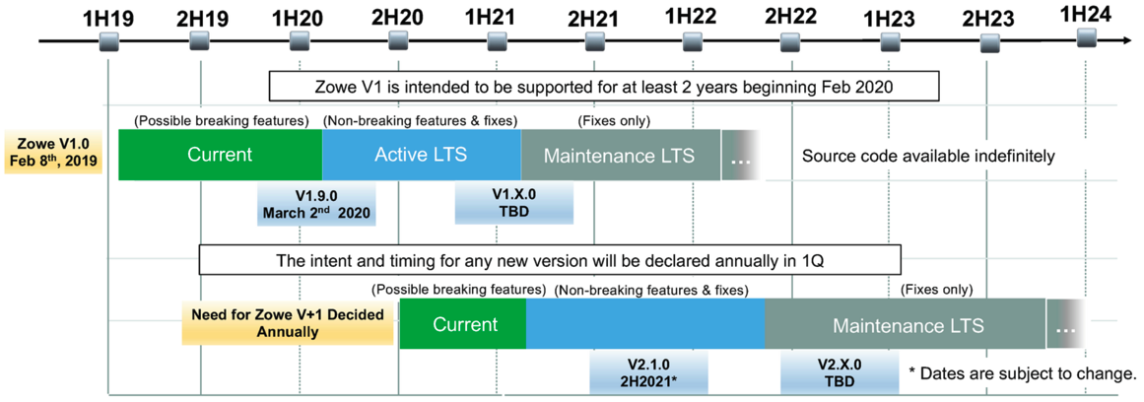
Zowe LTS release schedule
Active LTS
15

Slide 16
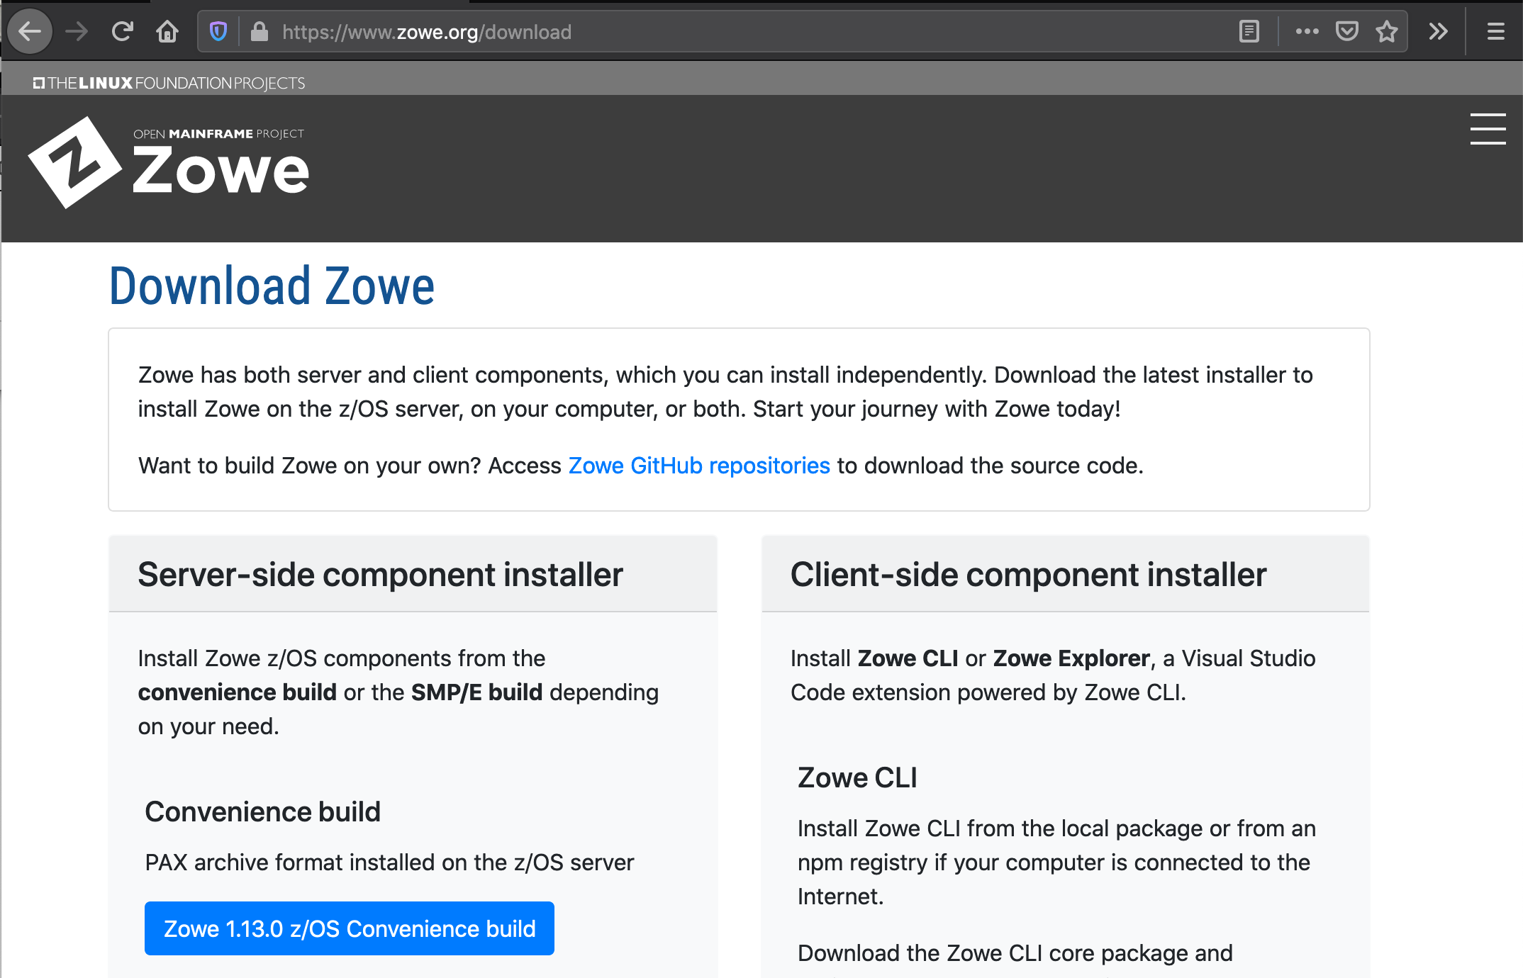
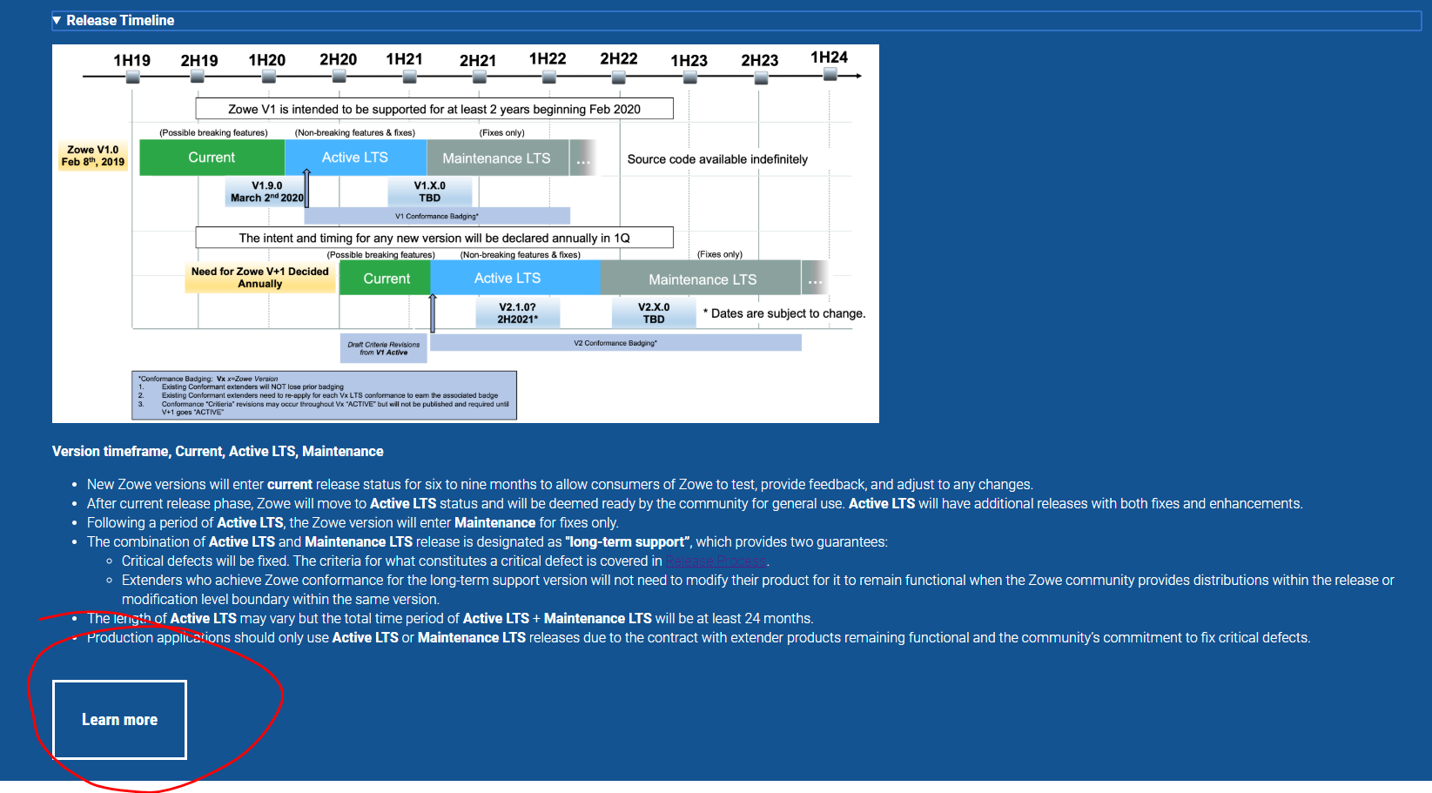
Where to go for additional information
Notes:
Fix red circle ;-)

Slide 17
Zowe Conformance Program

Slide 18
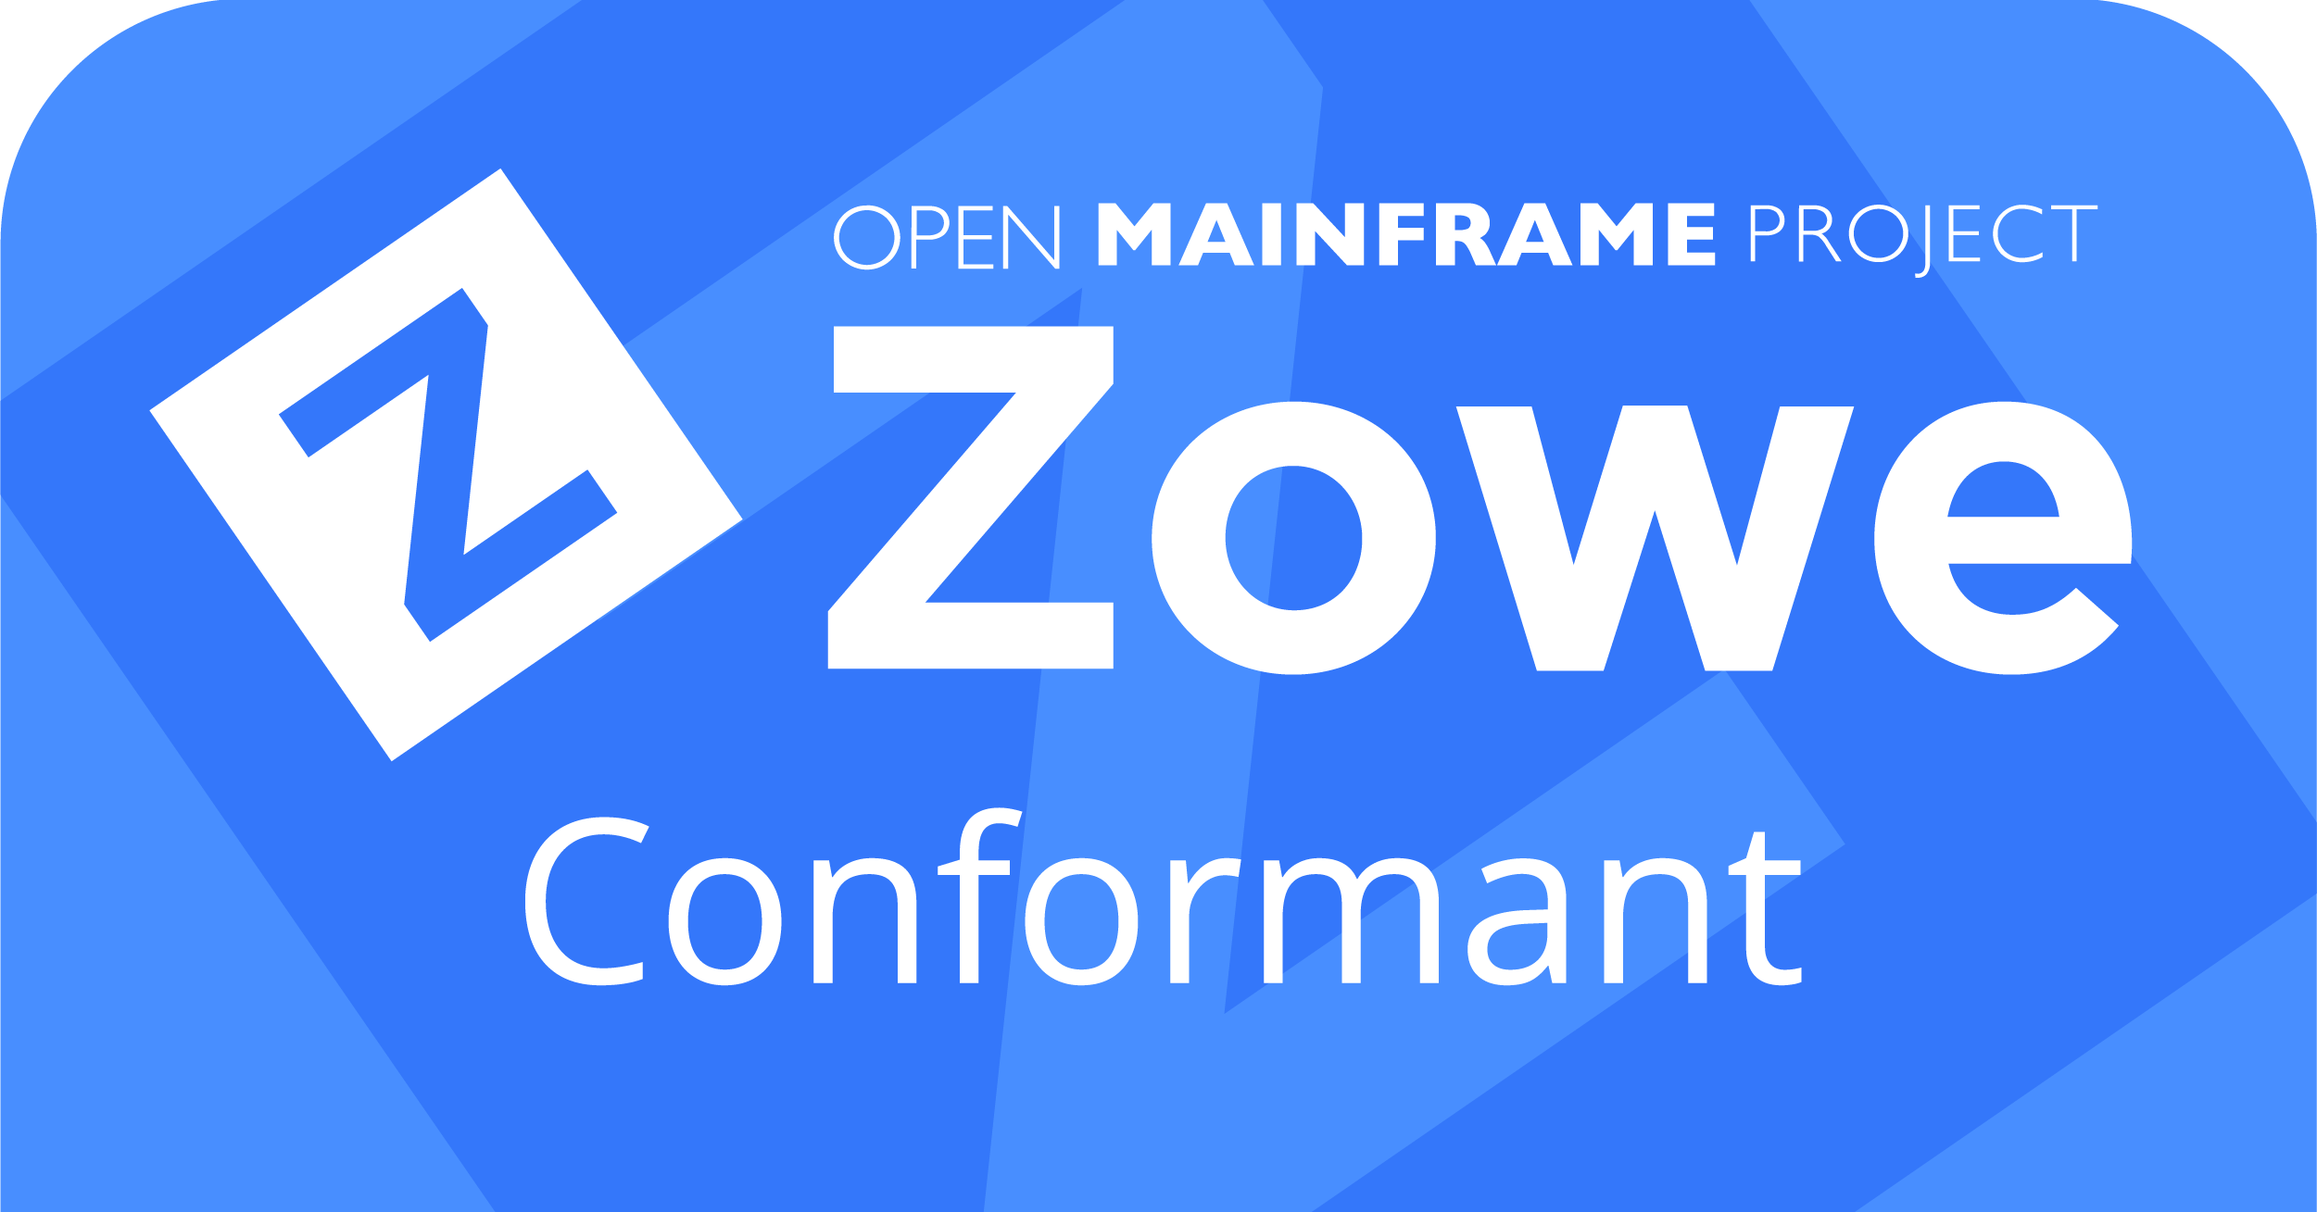
What is Conformance?
Zowe can be used “as delivered” or through plugins and extensions created by clients or 3rd-party vendors
Optional program developed by Zowe community directed towards “extenders”
Guidelines / minimum requirements
Technology Quality Gate
Earned “stamp” of approval
Notes:
The Zowe Conformance Program was developed by the the Zowe community as a means to ensure that each plug-in and extension associated with a given Zowe component has met a minimum set of requirements that enable them to deliver common functionality, interoperability, as well as a common user experience
Zowe Badging permits use of ZOWE Symbol.

Slide 19
Why Conformance?
Common functionality
Flexibility, Integration, Interoperability
Encourage, Improve Quality
Consistent User Experience
Benefits the PROVIDERS and the CONSUMERS
Notes:
The Zowe Conformance Program was developed by the the Zowe community as a means to ensure that each plug-in and extension associated with a given Zowe component has met a minimum set of requirements that enable them to deliver common functionality, interoperability, as well as a common user experience
As an EXTENDER of Zowe Conformant Applications:
Ensures my application will behave as designed in the Zowe ecosystem
Helps me to maximize the value of my application
Helps to ensure that other applications will NOT break mine
Demonstrates thought leadership / partnership
Allows me to market my application using the Zowe brand
As a CONSUMER of Zowe Conformant Applications:
Allows me to leverage a common stack of infrastructure across multiple vendor applications
Provides a level of operational confidence thru transparency
Offer the collective “quality assurance” of the community. i.e. all conformant applications have been vetted by the community

Slide 20
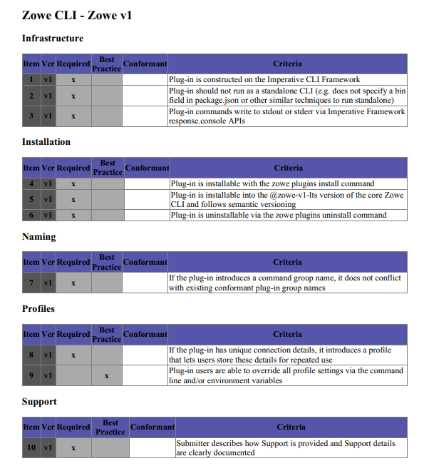
Updates for Zowe Conformance ZOWE v1
General Program Updates from Zowe Conformance 2019
Base version for conformance bumped up to Zowe 1.9 ( initial Active LTS release )
Test Criteria transitioned to table - checklist format and entries “tagged” with “LTS” #
Program materials maintained openly on Open Mainframe Project Github
Terms and Conditions modified to retain previous program revision badges
Ongoing Continuous Improvement
Community feedback and participation on Zowe Conformant requirements
Web Page / App Store look-and-feel
Incremental badge considerations

Slide 21
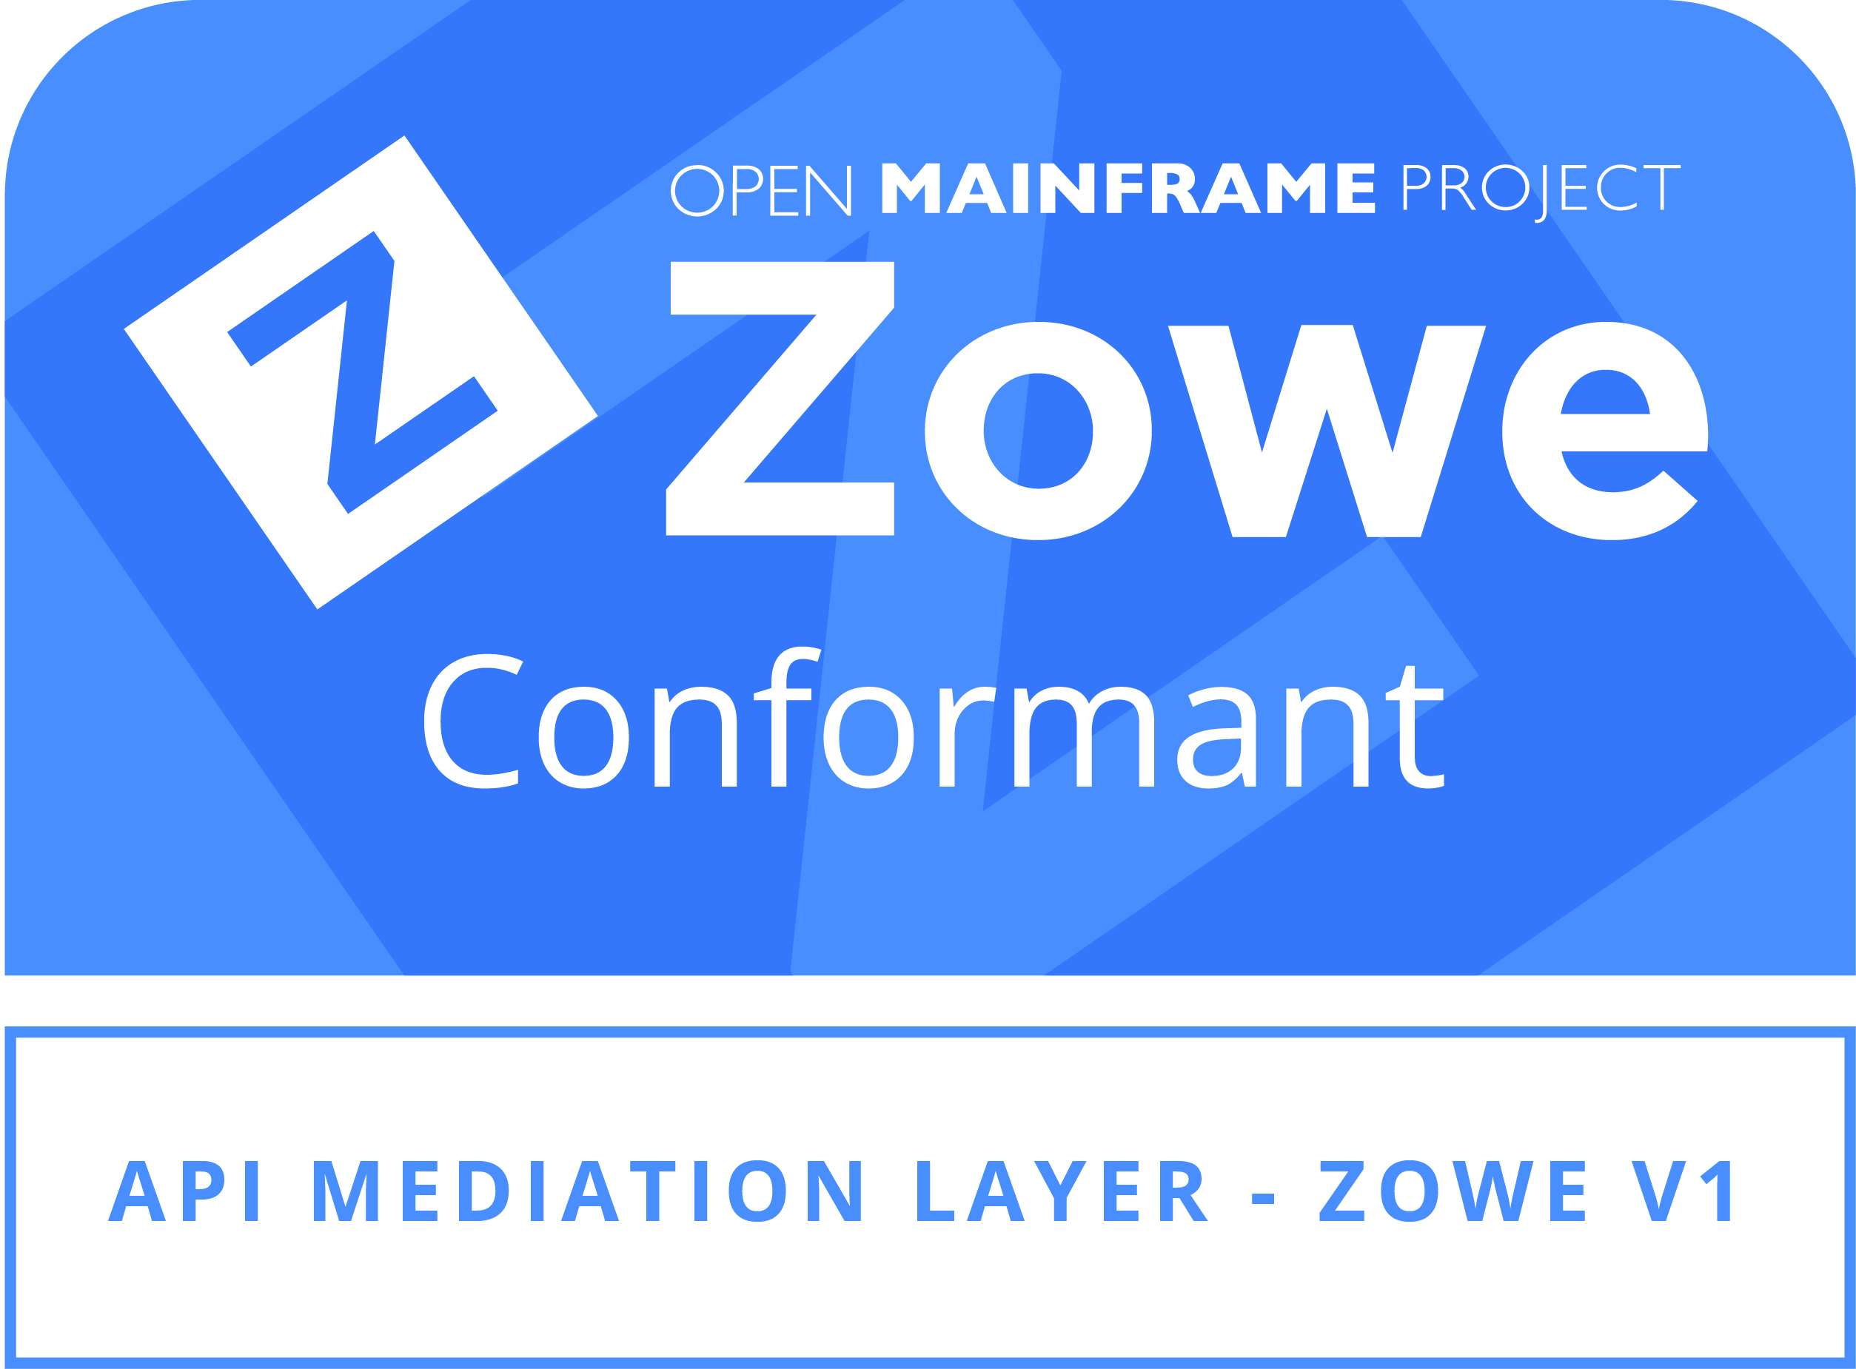
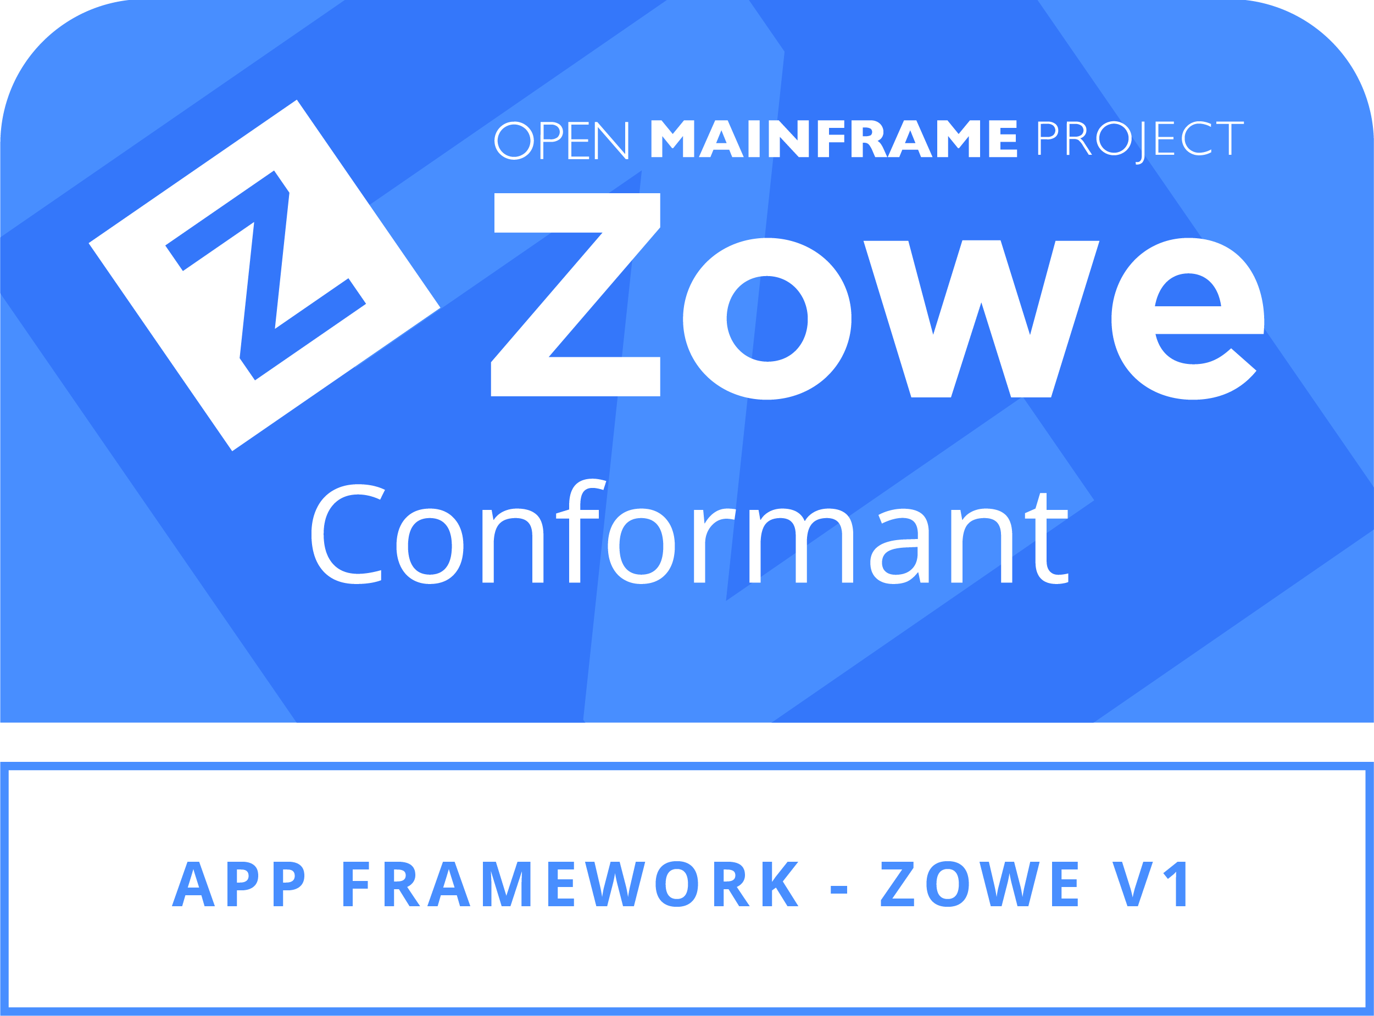
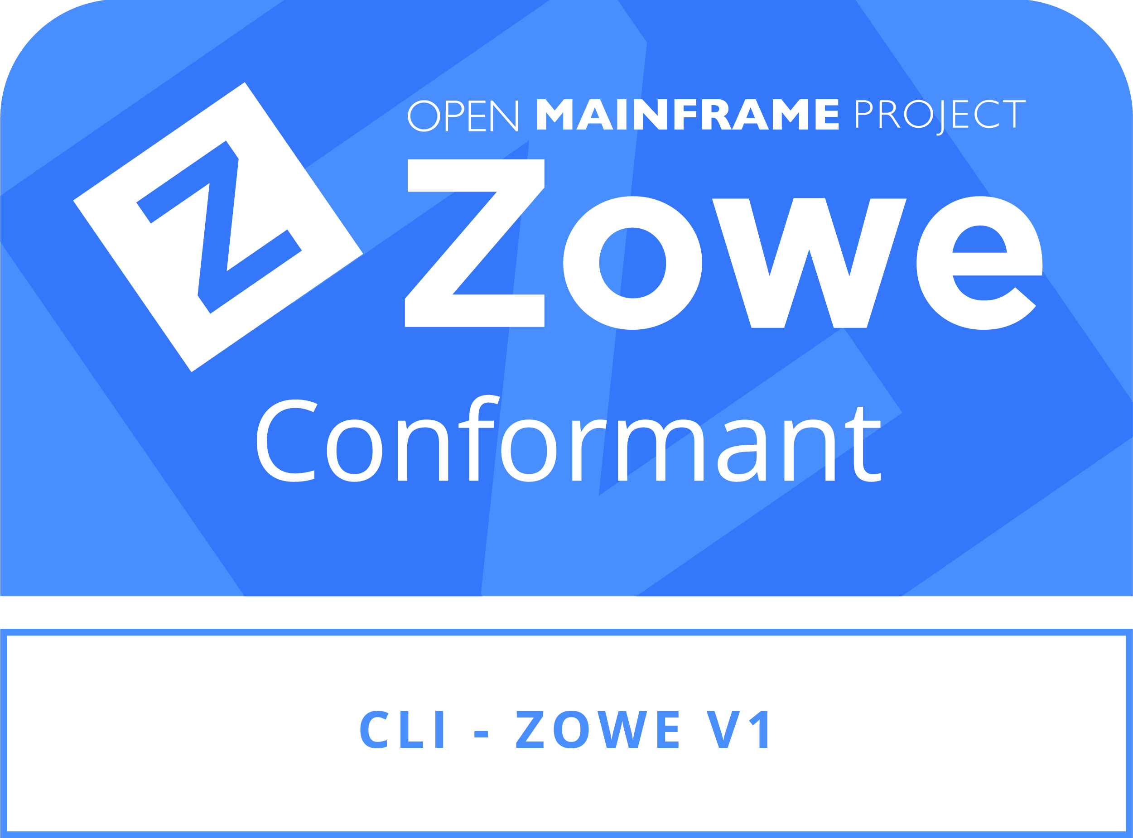
Anyone can apply for Zowe Conformance
Both new and previous Zowe Conformant 2019 offerings are eligible for Zowe Conformant ZOWE v1.
Program fees apply; waived for current Open Mainframe Project members.
3 Steps to Conformance: https://www.openmainframeproject.org/projects/zowe/conformance
Review Program Terms and Conditions
Complete Test Evaluation Guide
Confirm “required” entries are satisfied
Submit the Participation Form
Open Mainframe Project staff will independently and objectively review all submissions in confidence. Zowe community members may be contacted for questions, but the identity of a submitting organization or individual will not be disclosed.
Upon approval, Open Mainframe Project staff will notify the submitter and communicate on badging and publication of offering.
Notes:
4 Steps to CONFORMANCE:
Prepare: Review the program and the test evaluation guide(s)
Test: Follow the instructions for testing your application and submit your request
Submit: Submit your official request
Review: Your request will be reviewed and approved, your application will be “badged”
OMP reviews all applications
Vendor neutral
Ensure competitor confidentiality
Approves and posts terms and conditions
Un-biased assessment
Zowe Community
Determines, presents, and maintains the conformance criteria
Test Evaluation Guides
Terms and Conditions
Zowe Conformance Program
Manages “use of” Zowe Brand and Zowe Marks

Slide 22
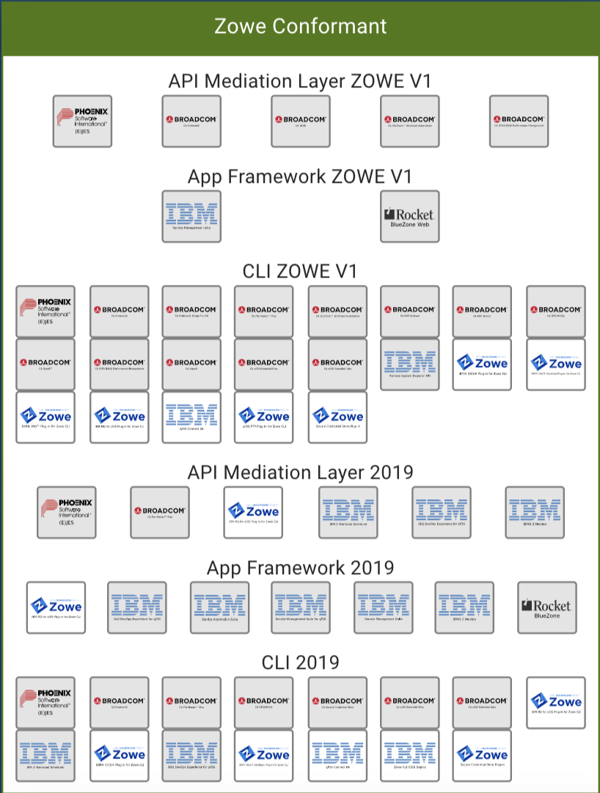
Current Zowe Conformant offerings Full List
Notes:
Explore how to make list better ( remove groupings and duplicates )

Slide 23
Getting help with Zowe Conformance
Are you building service APIs?
Are you planning a Zowe Web UI Plugin?
Are you planning a Zowe CLI Plugin?
Let’s be sure you can achieve Zowe Conformance!
Tips for achieving Day 1 Conformance:
Review the conformance program details now
Print the Test Criteria Guide
Include all “required” entries in your (technical) plans
Target a “submit-for-conformance” date
Contact OMP or #Zowe Onboarding (Slack Channel) if you need assistance

Slide 24
Zowe Features Here and Beyond - Enterprise and Production Ready

Slide 25
What constitutes “enterprise and production ready”?
TODO: Define and connect to customer expectations
Trust
It is secure from intruders and repsects role based aCLs
It will stay up and available through service and backend interuptions
It will scale automaticatly to meet changes
It can be maintained sustainability, in the way mainframe software has been traditionally maintained and heritage
Themes
Security
Resilience/Scaling
Serviceability
Notes:
Further slides expands on each point
Call out vendor support

Slide 26
How is Zowe enterprise and production ready?
The success of Zowe rests on
Customers and offerings built on top of Zowe to service, support, and trust Zowe as an enterprise ready platform to deploy and use
Vendor offerings built on top of Zowe to drive footprint and grow Zowe surface area

Slide 27
How is Zowe secure?
SSO support for all Zowe components
Interactive support
API support via JWT tokens
TLS1.2+/HTTPS support end-to-end for all Zowe components
SAF-based access for all Zowe components
ESM neutrality with coverage for RACF, Top Secret, and ACF2
MFA support for Application Framework and coming very soon for CLI
RBAC support for Application Framework
API calls and arguments supporting RBAC checks for application framework plug-ins
File system security for RBAC meta-data for application framework

Slide 28
How is Zowe resilient and scalable?
Inherent stateless design for API Mediation Layer and CLI
Failover and sysplex state synchronization planned for Q3 for Application Framework
Docker container support planned for Q3 for all z/OS components*
* Excepting ZSS micro services

Slide 29
How is Zowe serviceable?
See LTSR and CUPIDS
API support for viewing log output and setting log trace level dynamically
Supported in Application Framework and CLI

Slide 30
How is this work continuing

Slide 31
Benefits of Zowe being open source

Slide 32
Open source benefit and why

Slide 33
Case study of how this benefits you

Slide 34
Ways to get involved

Slide 35
Zowe as a part of the Open Mainframe Project

Slide 36






A Few Ways to Participate
Subscribe to Open Mainframe Project Mailing Lists | Attend Upcoming Mainframe Events | Get the latest development updates from the technical communities
Engage in the discussion on Slack | Start or join a local Open Mainframe Meetup | Participate in the Forums

Slide 37
Mission of the Open Mainframe Project:
Build community and adoption of Open Source on the mainframe
Eliminating barriers to Open Source adoption on the mainframe
Demonstrating value of the mainframe on technical and business levels
Strengthening collaboration points and resources for the community to thrive

Slide 38
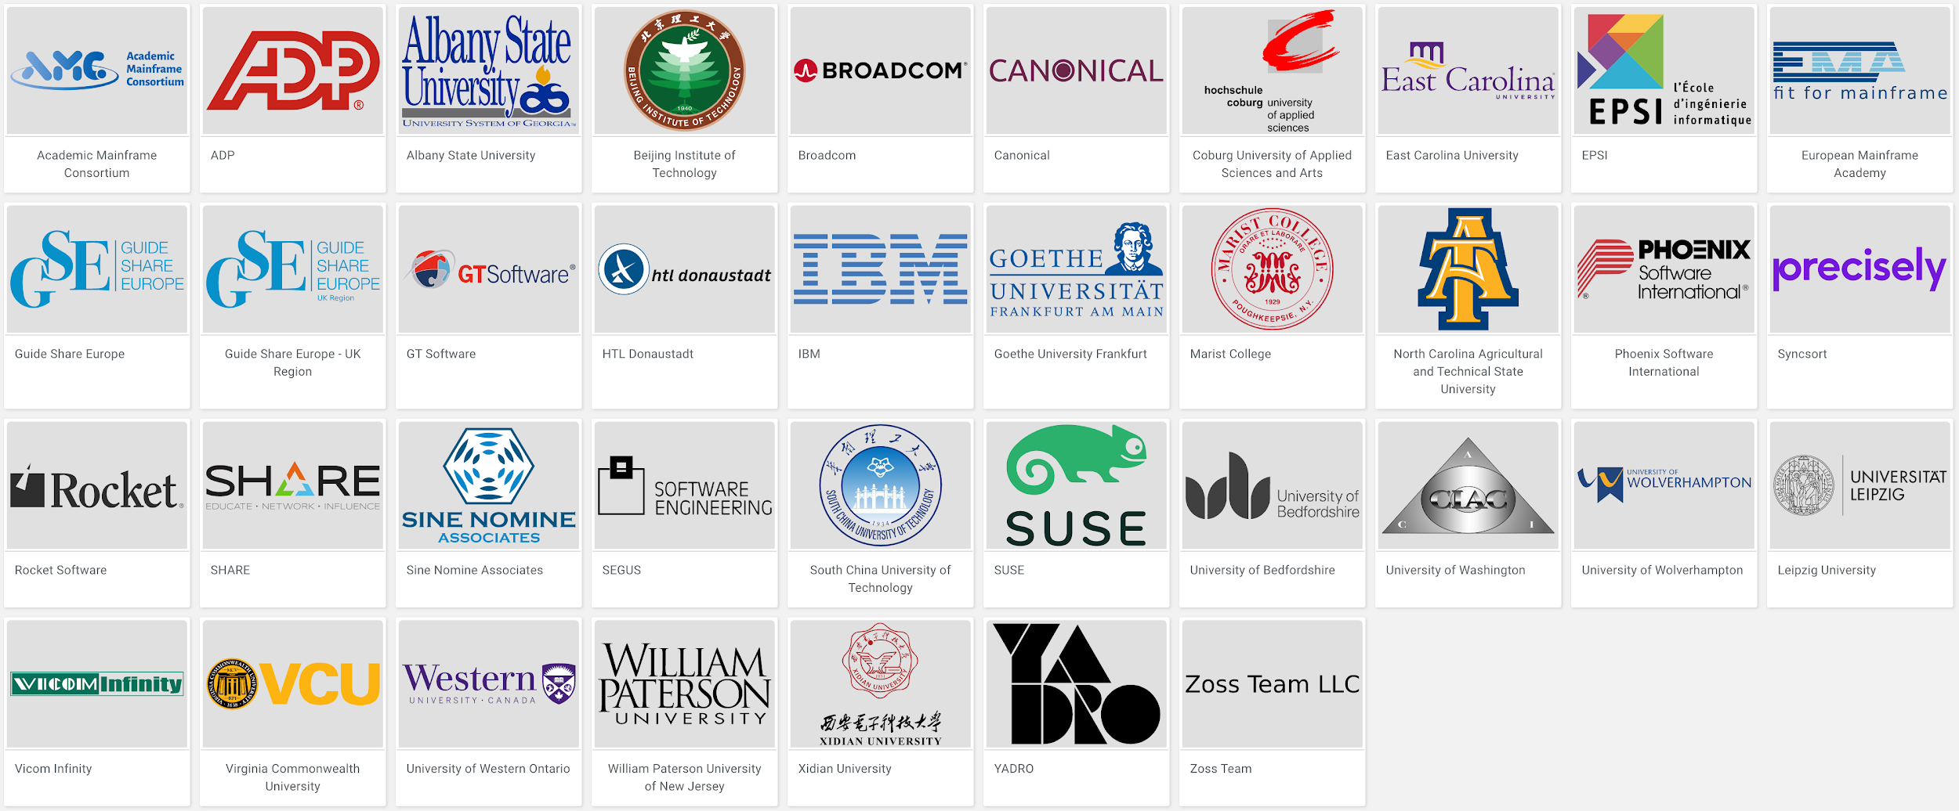
Open Mainframe Project Momentum
5 years since launch | 37 Supporting Organizations | 12 Hosted Projects | 40+ Mentees Sponsored | 100+ Students Impacted | 200+ Project Contributors

Slide 39









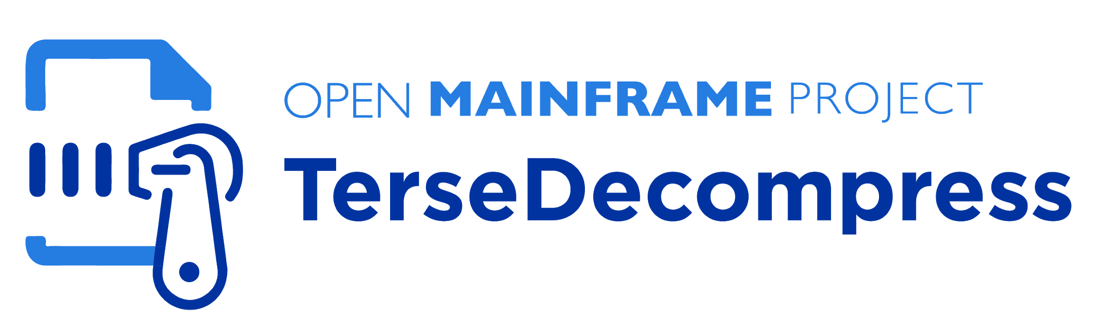
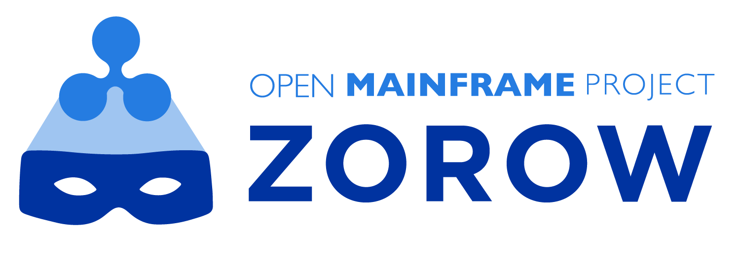
Mainframe-centric projects hosted
Active Projects
Incubation Projects
Learn about all Open Mainframe projects at https://www.openmainframeproject.org/projects

Slide 40
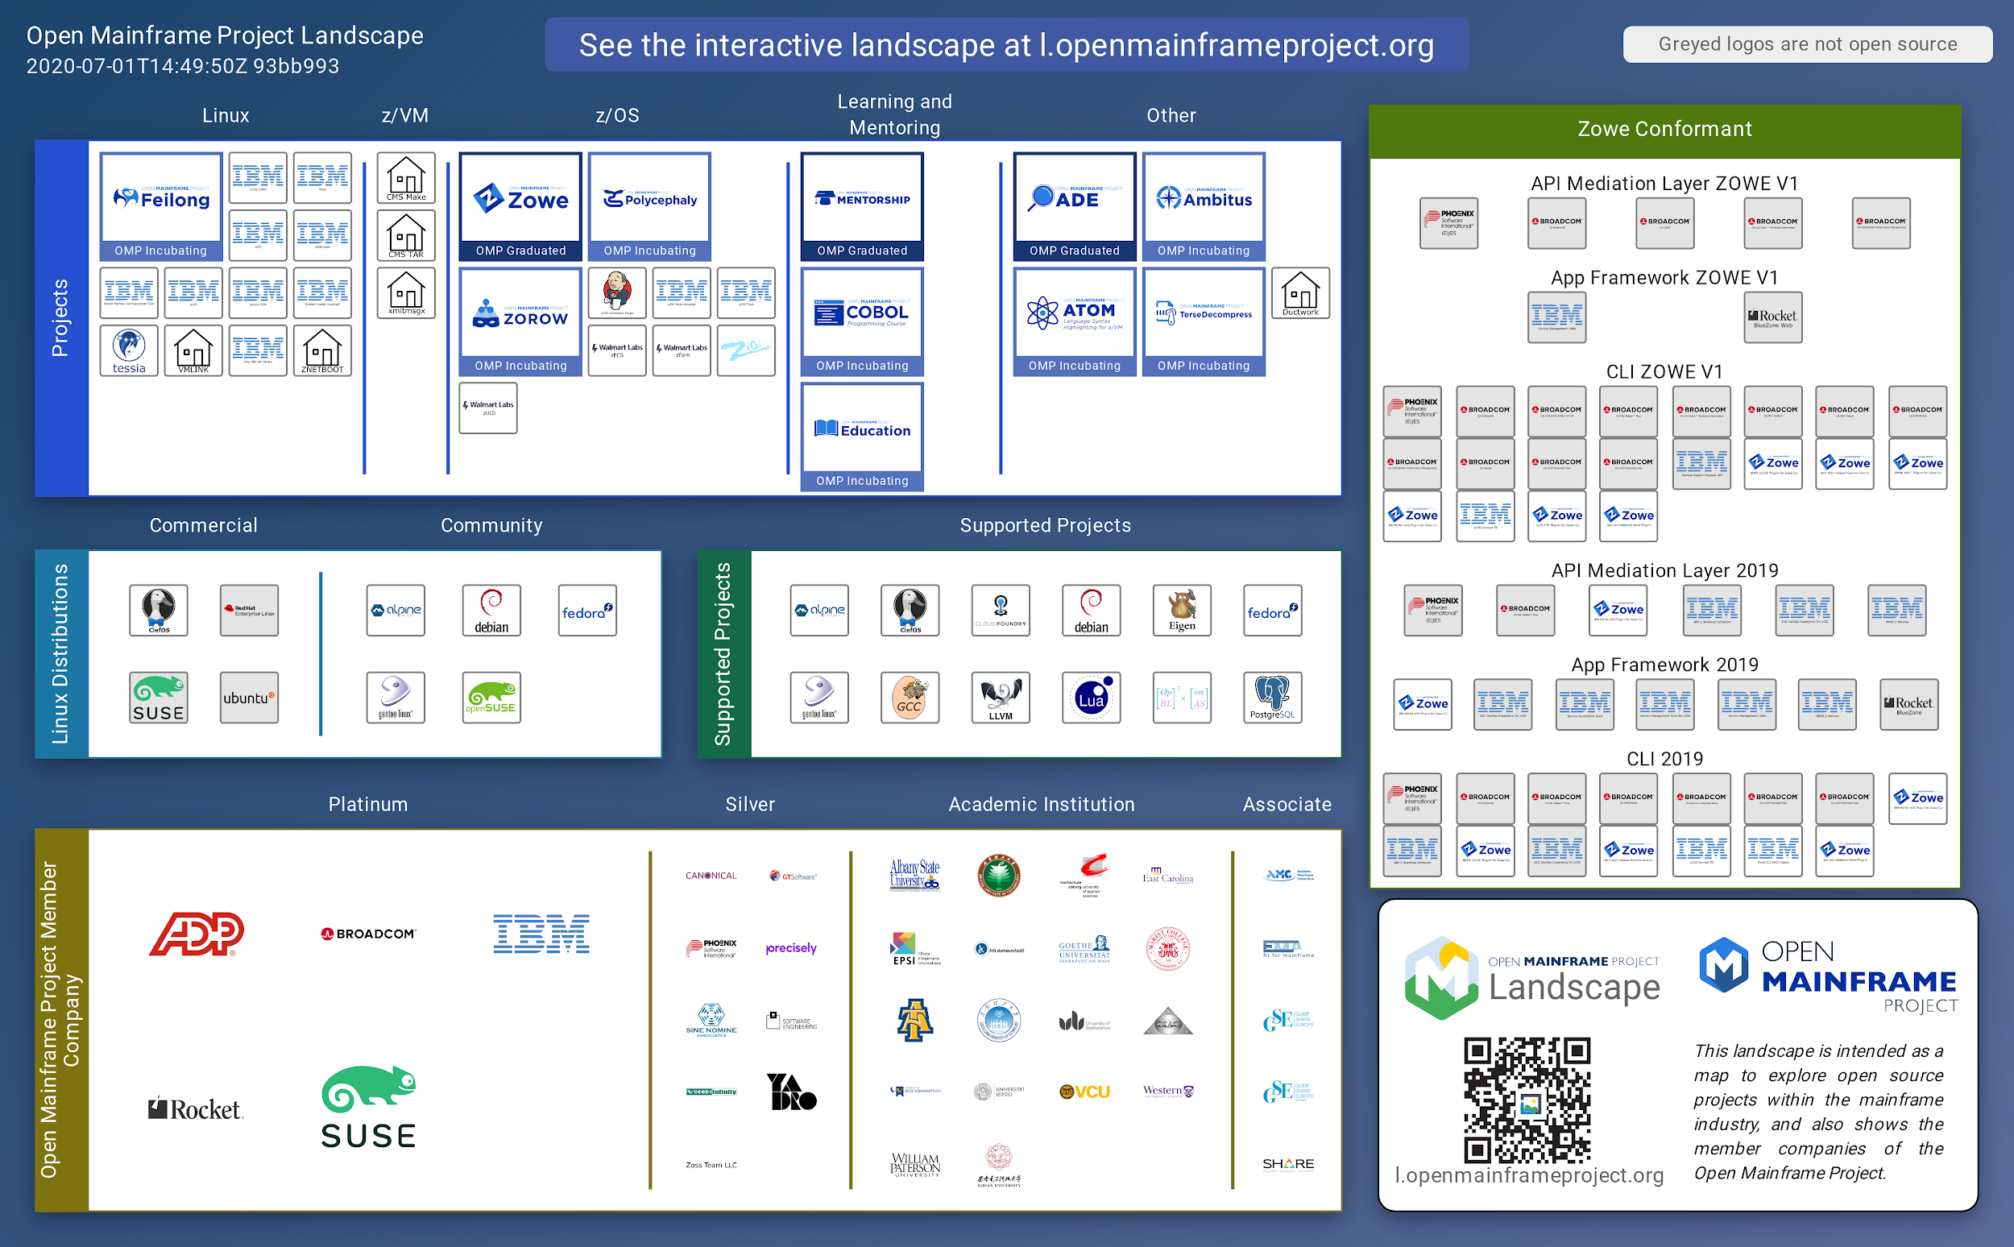
Showcasing the commercial ecosystem building from Open Mainframe Project hosted projects
Supporting a strong open source ecosystem on mainframe is crucial to sustainability. The Open Mainframe Landscape is key to identifying and understanding the dynamics.
Visit https://l.openmainframeproject.org to learn more.

Slide 41


Make sure you are follow us on social!
Follow us on LinkedIn at https://www.linkedin.com/company/the-open-mainframe-project
Follow us on Twitter at https://twitter.com/OpenMFProject

Slide 42
Questions?

Slide 43
Thank you!
@openmfproject

